Slide 1
HR ANALYTICS Project
Swapnil Paraskar

Slide 2
Problem Statement
Chart’s Requirement
Attrition by Gender:
The HR Department faces challenges in understanding the attrition patterns based on gender, making it difficult to identify any gender related disparities and implement targeted retention strategies.
Department wise Attrition:
The HR Department lacks visualizations to showcase attrition rates across different departments. This hinders their ability to identify departments with higher attrition rates and address any underlying issues or concerns effectively.
Attrition by Age:
The HR department requires visual representations to analyze the attrition of employees across various age groups.

Slide 3
Job Satisfaction Ratings:
The HR department lacks visualizations to represent job satisfaction ratings, hindering their ability to measure employee engagement and overall job satisfaction levels effectively.
Education Field wise Attrition:
The HR department requires visual representations to analyse attrition rates based on education fields. This helps identify specific educational backgrounds that may be associated with higher attrition, enabling the organisation to tailor retention strategies accordingly.
Attrition Rate by Gender for Different Age Groups:
The HR department lacks visualisations that display attrition rates based on gender and different age groups. This makes it challenging to identify any age and gender-related attrition trends, preventing the organisation from implementing targeted retention strategies for specific employee segments.

Slide 4
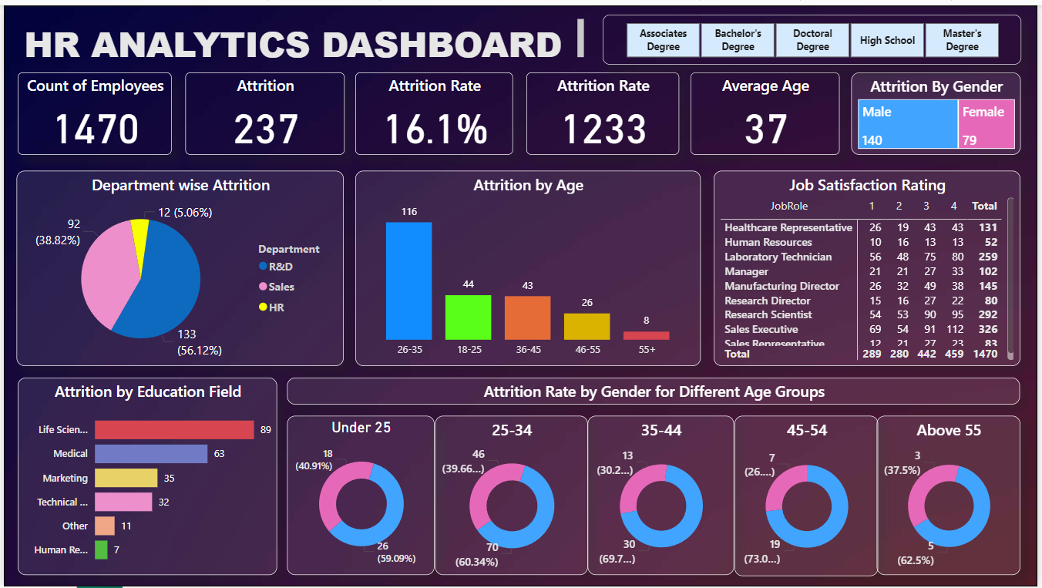
Power BI

Slide 5
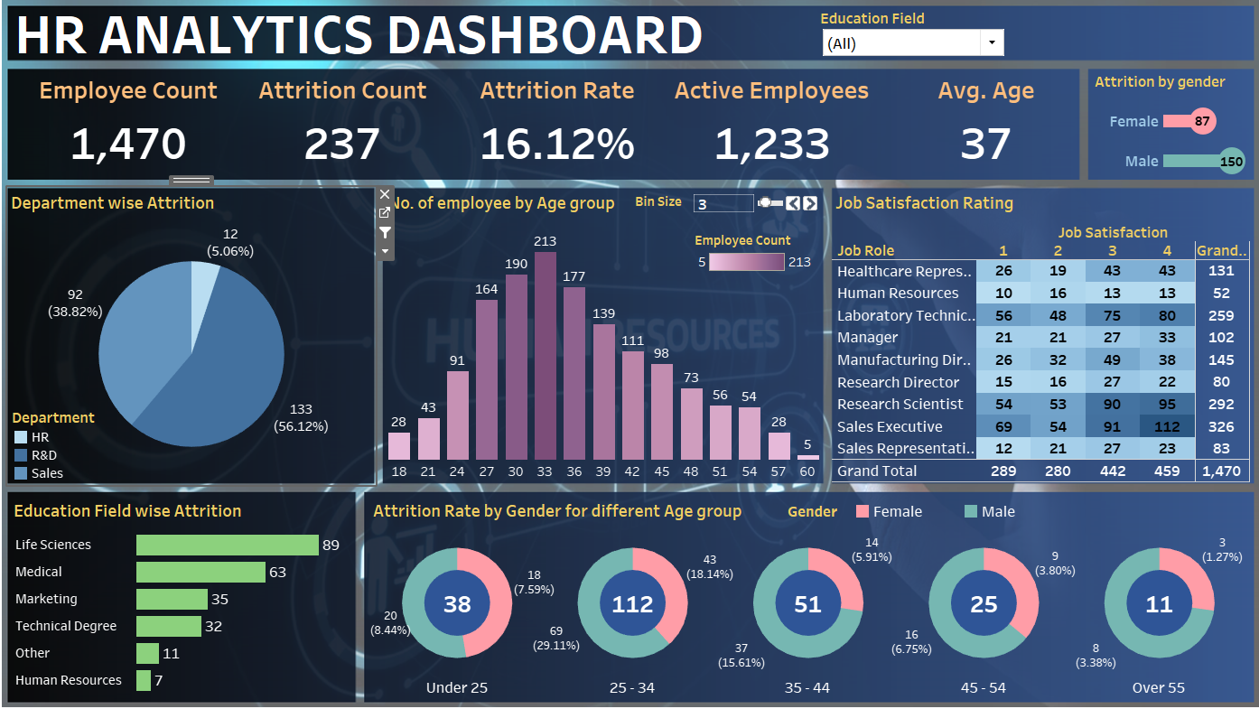
TABLEAU

Slide 6
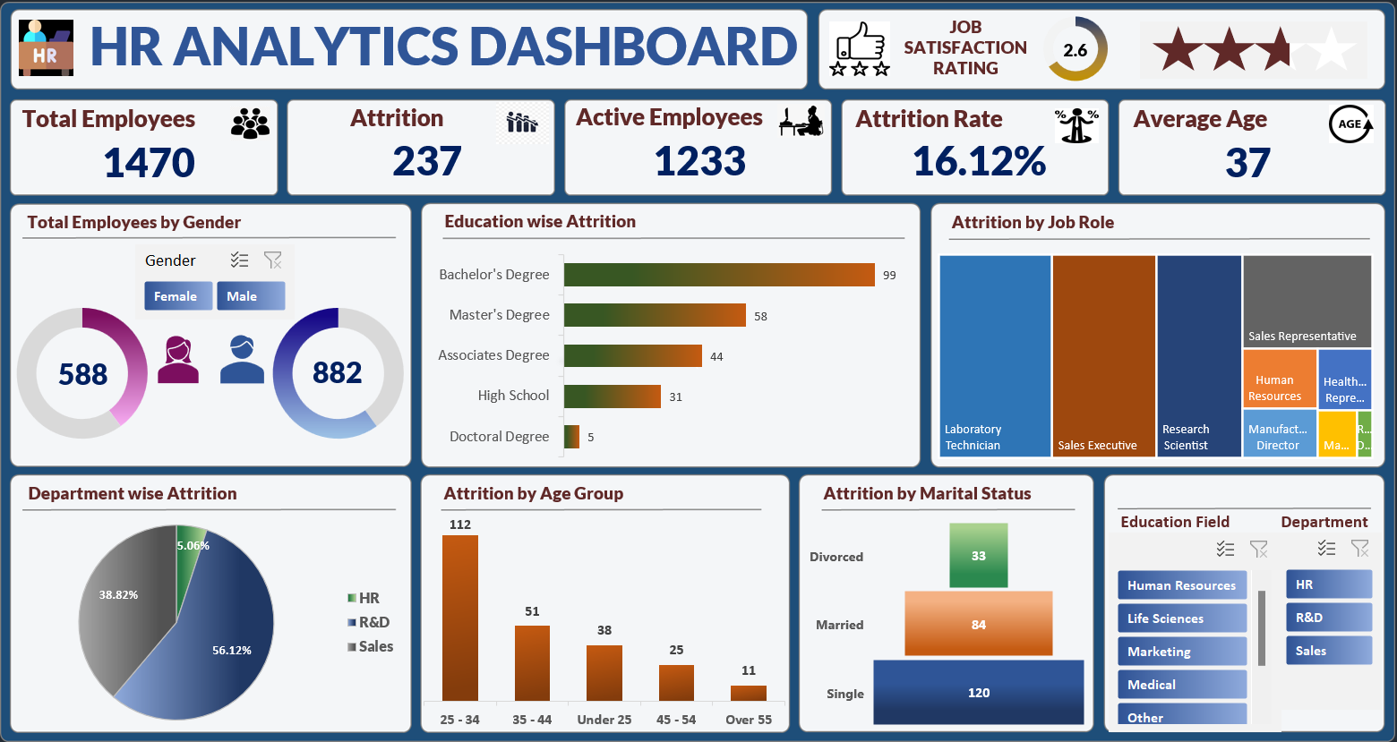
MS Excel

Slide 7
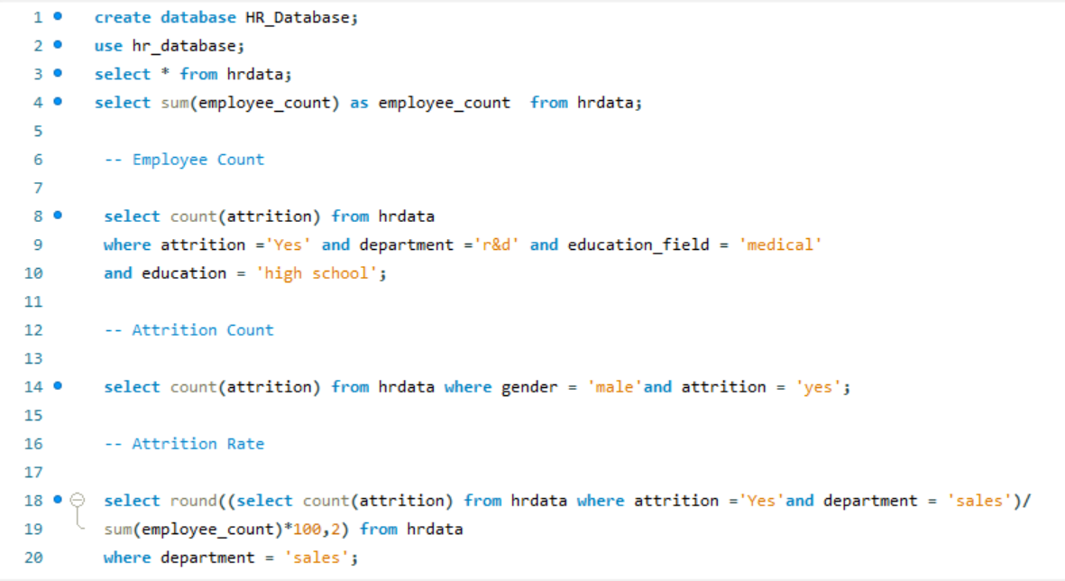
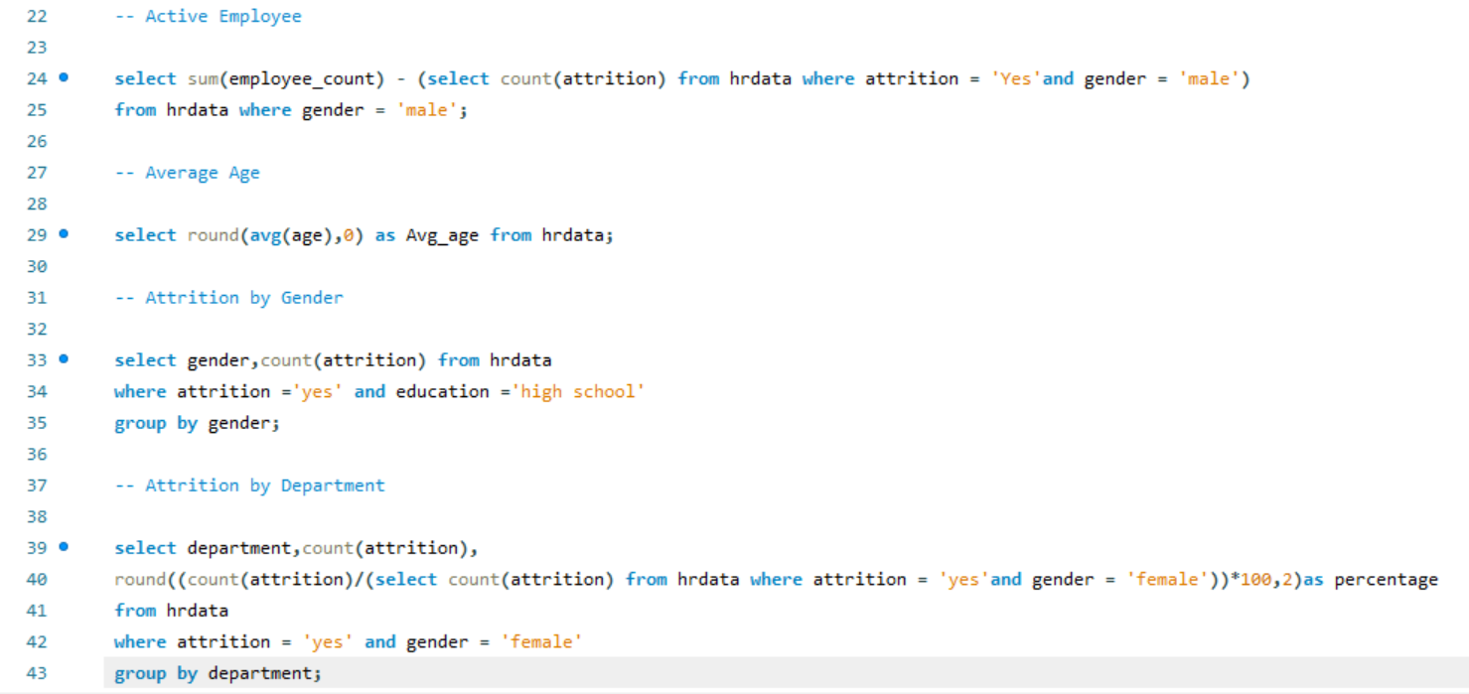
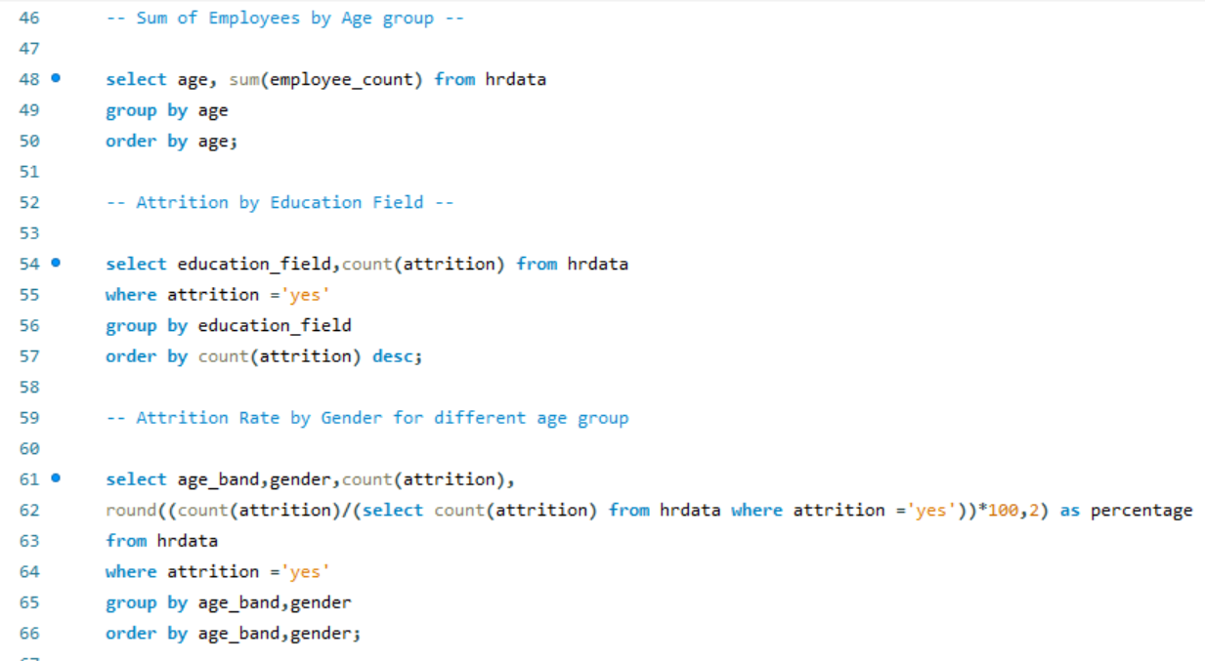
MySQL(Queries)

Slide 8
Thank you
Swapnil Paraskar
swapnilparaskar78@gmail.com

